Slide 1
Phase 3: Plotting and Ballistic Trajectory
Team FOXTROT
2d Lt Claire Badger
2d Lt Mark Demore II
2d Lt Brennen Garland

Slide 2
Group Steps to Complete Deliverable
Enumerate steps taken by group to accomplish deliverable
Badger – gnuplot, key presses, ribbon
Demore – debugging, fixing hyperplane/sensor relation
Garland – asynchronous plotting, threading
What arose based on preliminary plan?
Behind on timeline
Threading and asynchronous plotting
Debugging (replicating errors)

Slide 3
Design Decisions
Justify your Software Quality Attributes
Plots are members of the radar sensor object
Easy flow of data across sensor and plot
Asynchronous plotting updates with world
Ensures constant updating without bogging down gnuplot
What Patterns did your group employ? Why?
Active Object Pattern
Threading
Separates invocation from execution

Slide 4
Lessons Learned
What worked?
Group flow was very effective
No major merge conflicts
What did not?
Timeline
Debugging
If you could send a message back through time, what would you tell your group?
Threading and synchronous plotting is not as easy as you might think

Slide 5
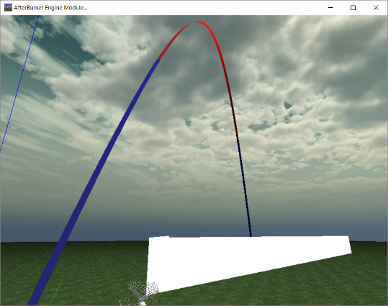
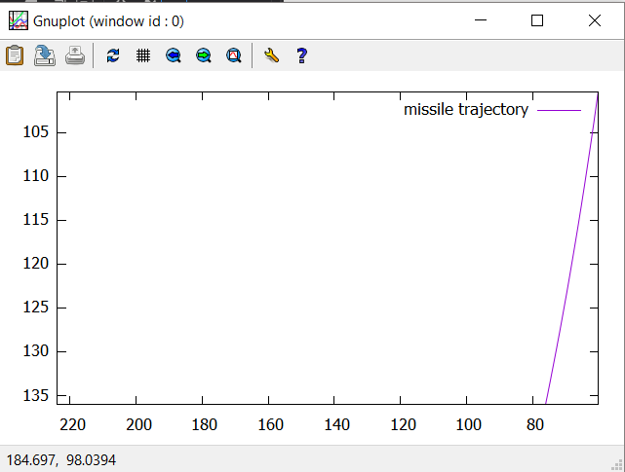
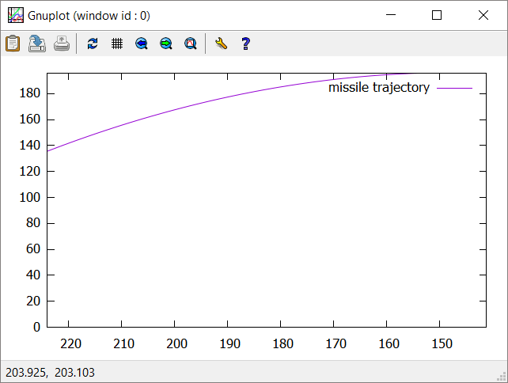
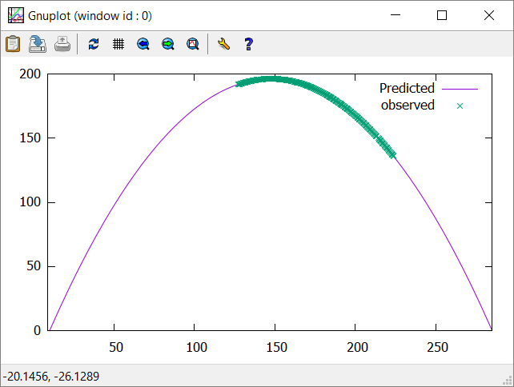
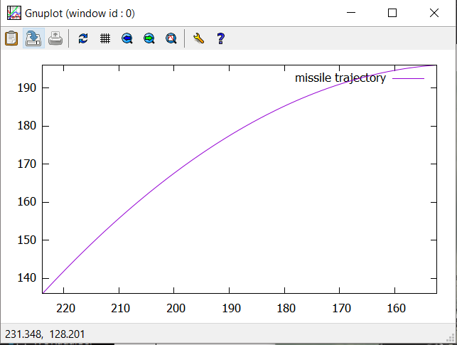
Images of Plots / Performance Analysis
When does it fail?
Gnuplot sometimes plots a point out of scale on async plot
When does it work?
The rest of the time

Slide 6
Team Hours and Morale
Lt Badger(20 hrs)
Time sinks: threading
Current morale: Lower than an F#
Lt Garland(16 hrs)
Time sink: asynchronous plot updating
Current morale: Lower than the Mariana Trench
Lt Demore(10 hrs)
Time sink: debugging
Current morale: Lower than his own self-esteem

Slide 7
Questions?

Slide 8
Grading
81 / 100
Upon clean build, “gnuplot-iostream.h” is not properly included, cannot compile your source code, had to adjust files to make compile -7
Many GLViewDefenseDaemon.cpp compilation warnings about narrowing conversion -3
ActiveObject creates async plot, but the plot scales and values are not correct, plot doesn’t stop after missile leaves bound -4
GNUPlot scale is not correct, roots computed are not correct -5
Total 100 Points
Phase 3 Test / Demo
Missile Trajectory
Radar Properly senses tracked objects
Modifiable Sensor Location
Plotting
Observed Plot
Predicted Plot
Quadratic Root Finding Functionality
Integrating 3rd party code
Required Behavior
GNU Plot does *NOT* block the 3D Virtual World
Can show both plots simultaneously
Asynchronous Plotting
Active Object Pattern implemented correctly
Plots real time data without blocking or switching focus

